Slide 1



Mini Project Presentation
Random Password Generator
Submited By:- ROHIT JOSHI 2018663 B

Slide 2

RANDOM PASSWORD GENERATOR
What is Random Password Generator ?
A password generator is an application that can auto- generate passwords for you.
These generated passwords are comprised of letters, numbers, and symbols.
This application helps the user create a solid password that cannot be easily guessed or brute-forced.

Slide 3
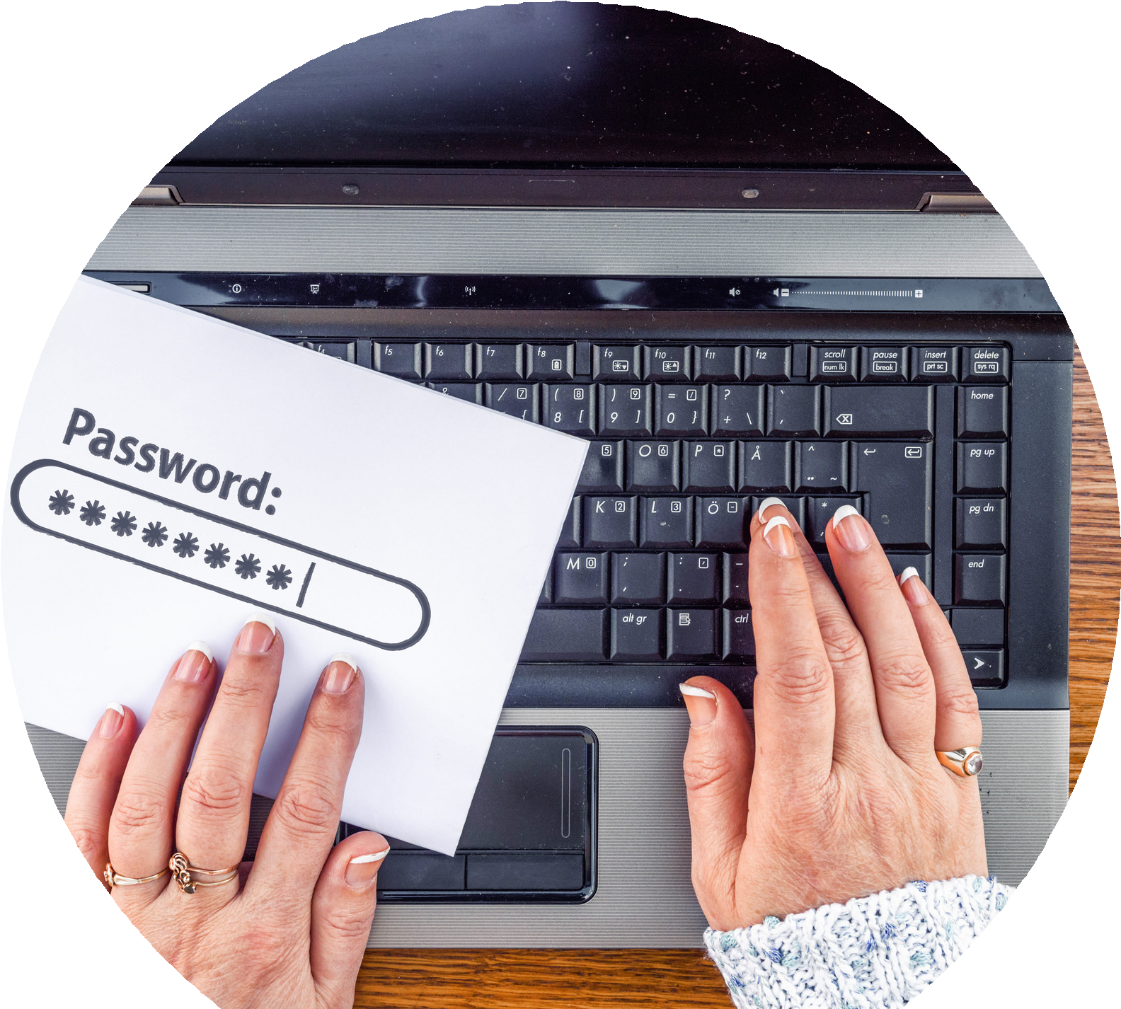
It's Implementation
As hacking and phishing scams become more advanced, many developers are taking extra precautions to protect their users. One example is implementing a random password generator, which prompts a user to select a completely randomized password when registering on a site or application, reducing the chances of hackers guessing or stealing login credentials.

Slide 4
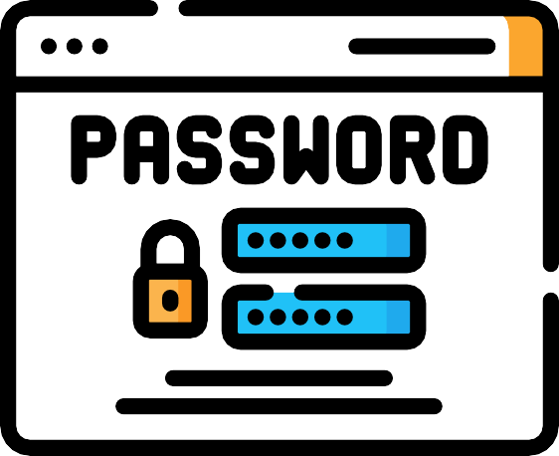

About our Mini Project
Our program will generate a random password of a specified length and character composition. After the password is generated, it will give you the option to be copied to your clipboard, meaning it’s ready for use.

Slide 5



Tools And Languages Used
A Code Editor it can be Notepad but here we are using Visual Studio Code Editor.
Languages used:- HTML, CSS, JAVASCRIPT
Hostinger/Git Hub for Hosting our website.

Slide 6
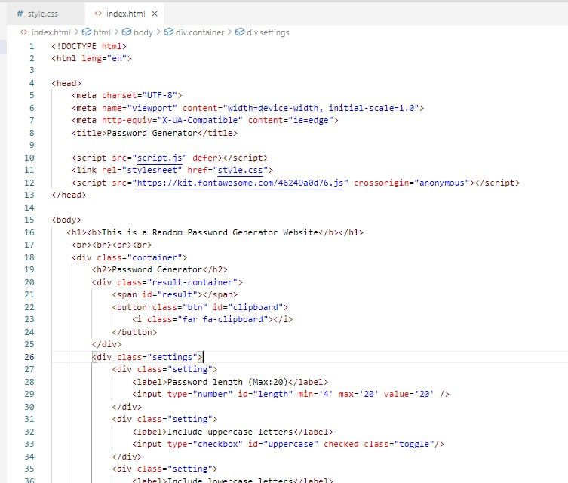




HTML:- Used to Structure our webpage.
CSS:- Used to design our webpage.
JavaScript:- Gives Functionality to the elements of a Web page

Slide 7
Challanges Faced
First challange which i face was that how to generate the random numbers.
And I overcome it by gaining a overview of javascript.
In JavaScript, this can be achieved by using Math.random() function.
Another challange which i face was how to host my website for free.
For this I surf the internet and find that I can host my website on github also.

Slide 8
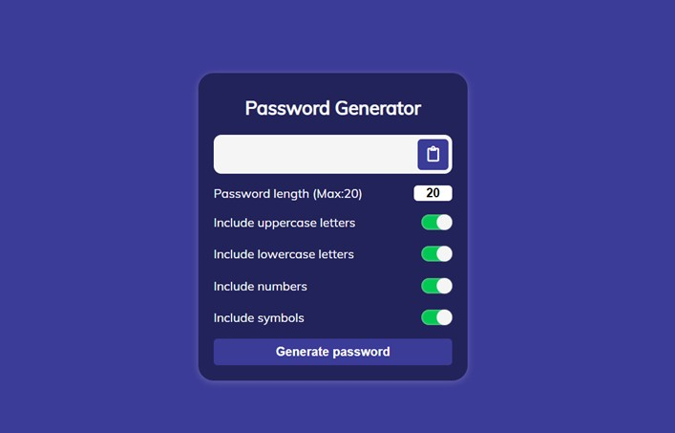
Finally Our website is ready fully working.
Link :- https://myrandompassword.000webhostapp.com/
Link :- https://rohitjoshi10.github.io/RandomPassword/

Slide 9
THANK YOU

